Slide 1
Intro to Python Part 1
Benjamin Rudski
October 28, 2024

Slide 2

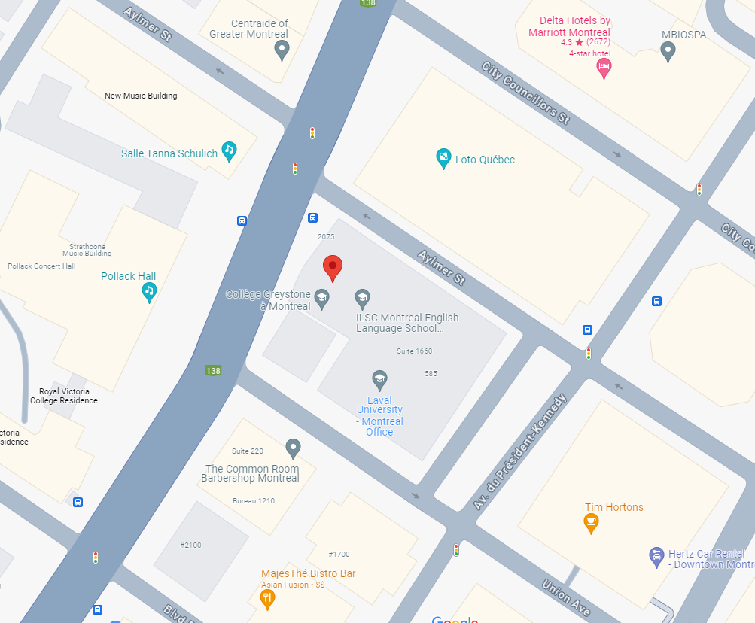
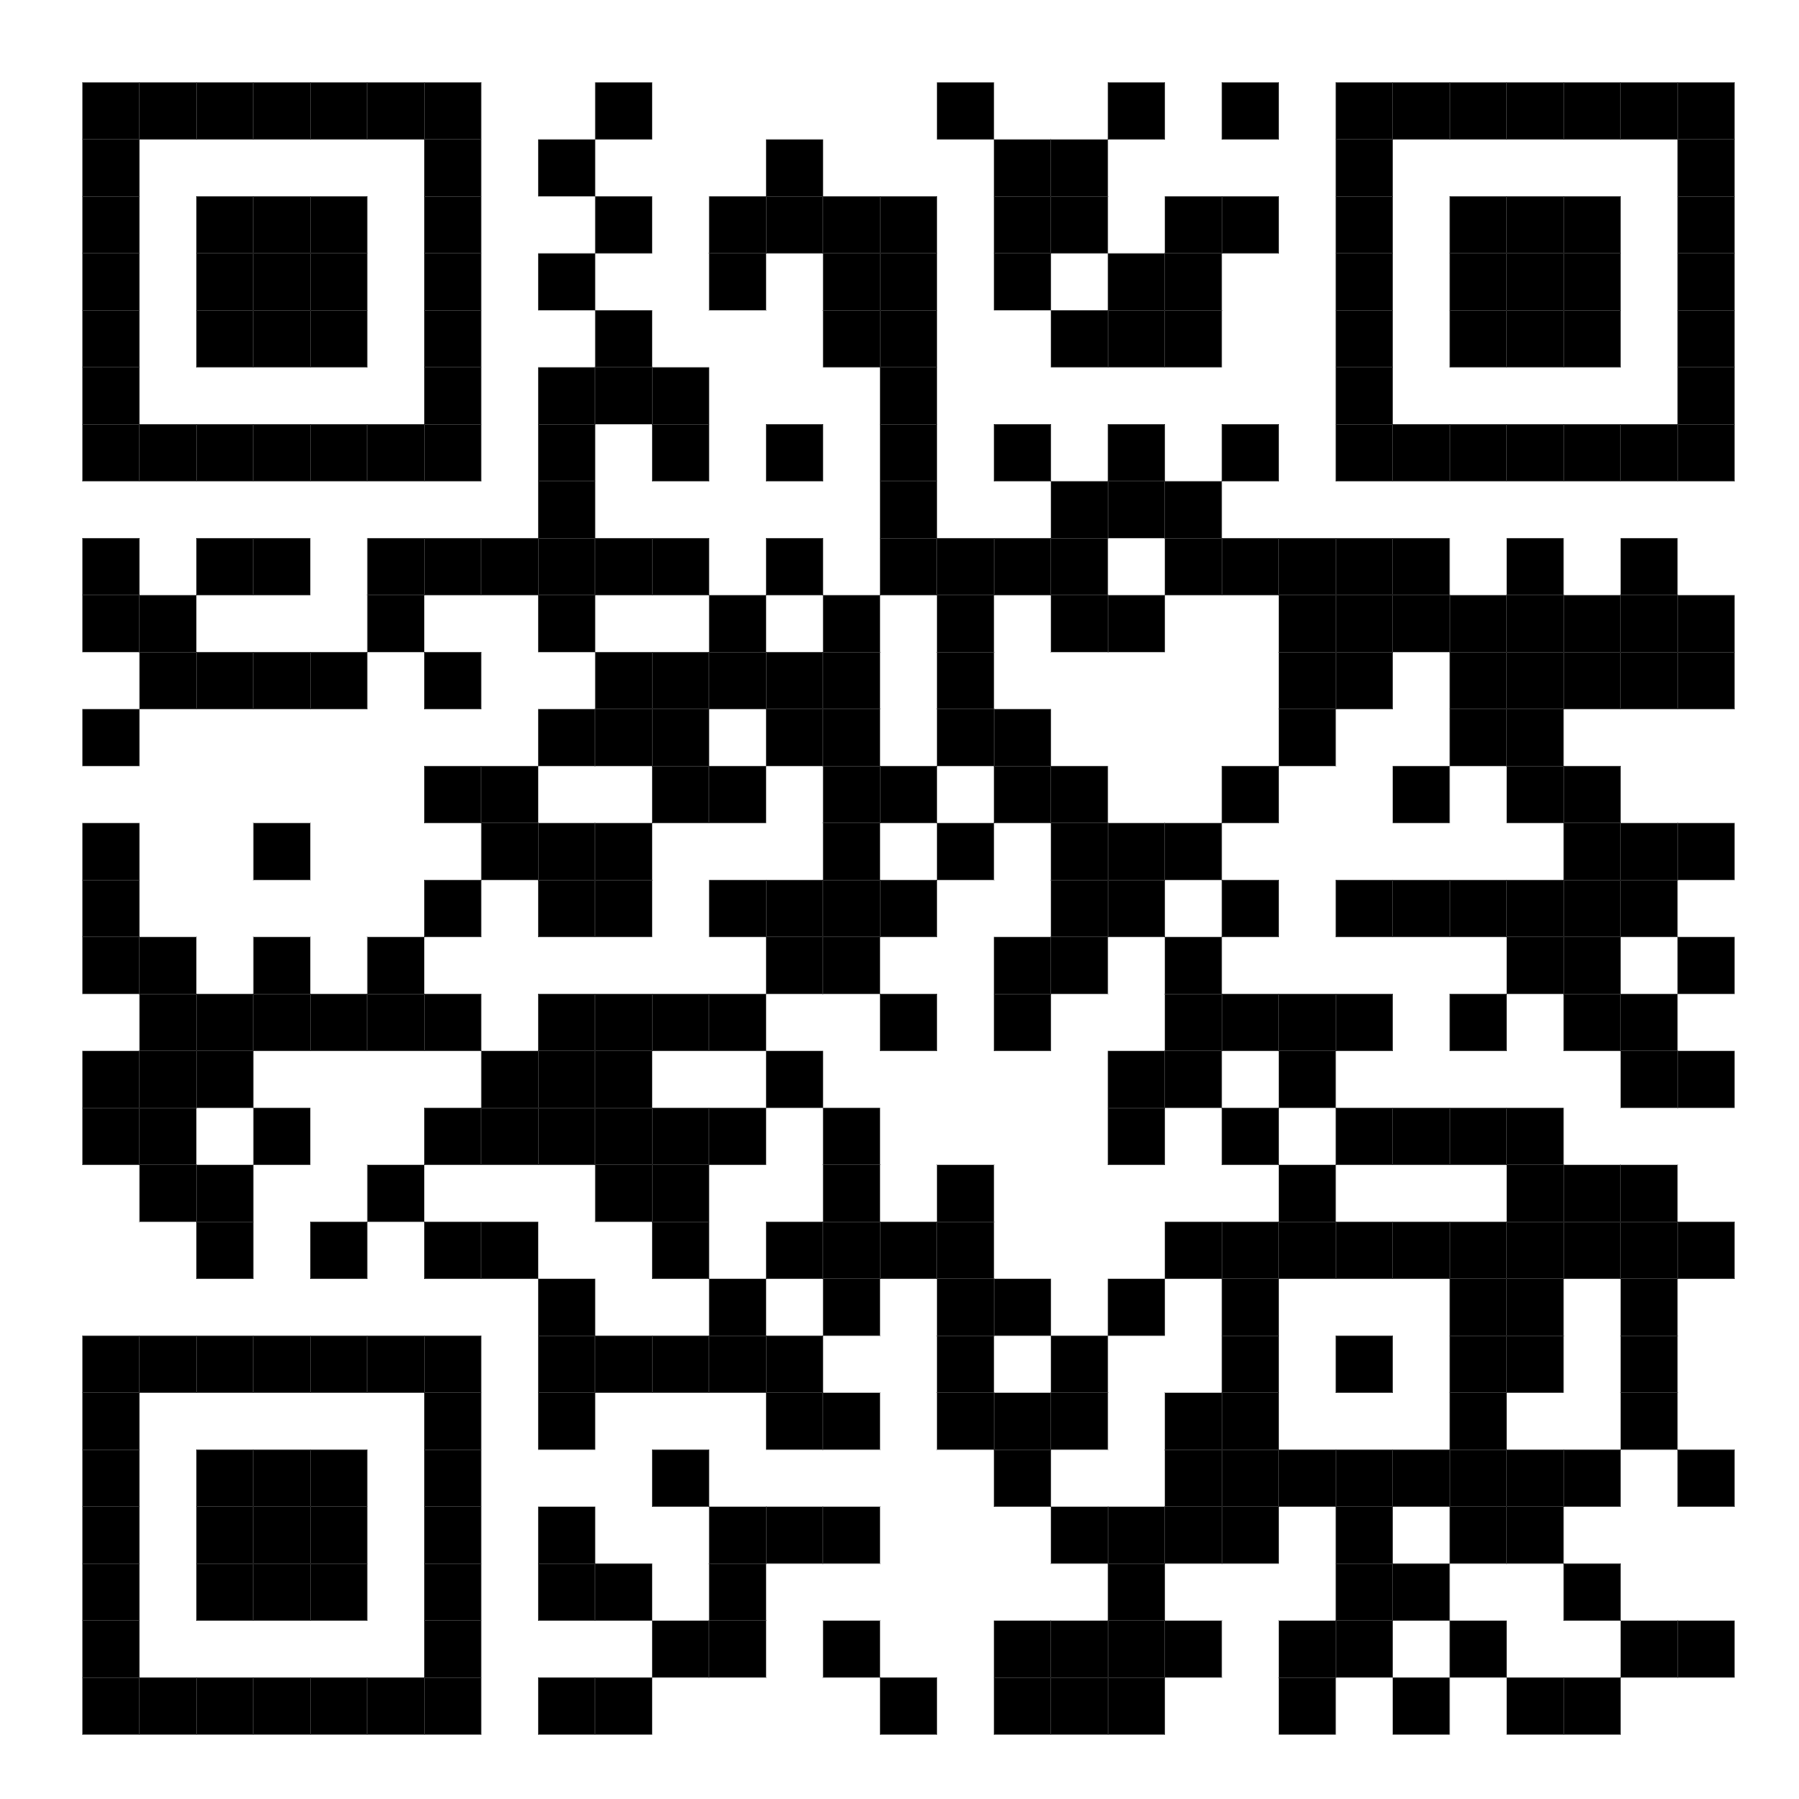
QLS-MiCM mission statement: deliver quality workshops designed to help biomedical researchers develop the skills they need to succeed.
Location: 550 Sherbrooke Street, Montreal, Quebec
Scan the QR code to sign up
for our mailing list
Contact: workshop-micm@mcgill.ca

Slide 3
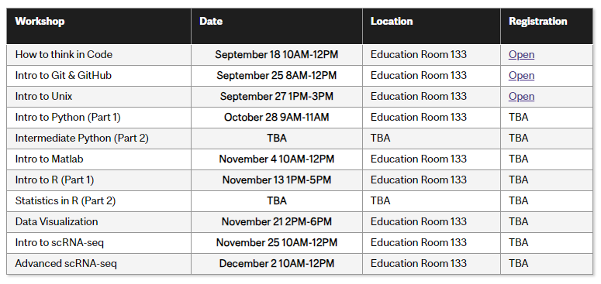
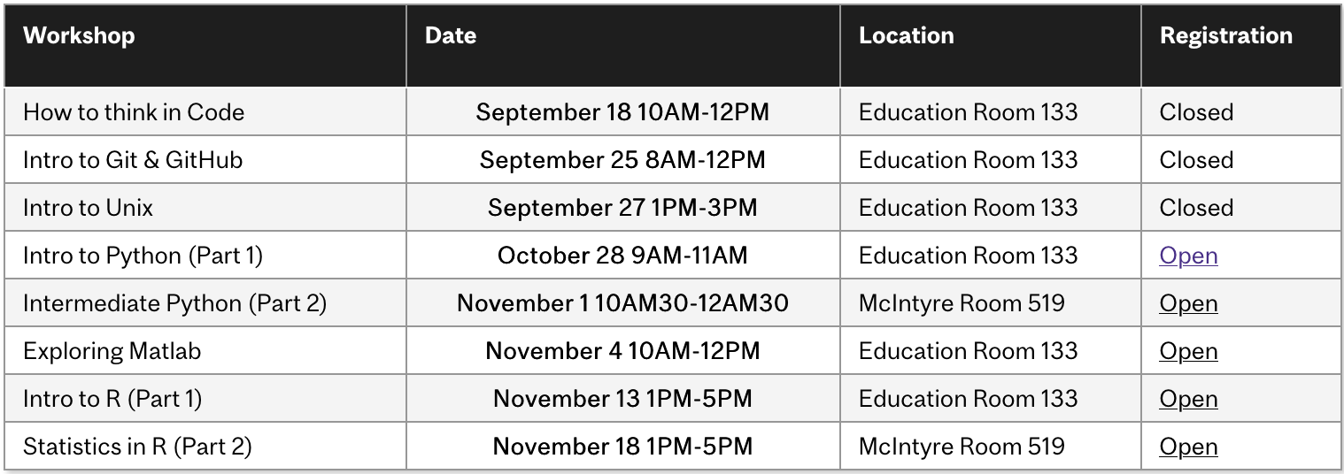
Workshop Series
https://www.mcgill.ca/micm/training/workshops-series

Slide 4
Outline
Module 1 – Introduction to Python (10 minutes)
Welcome to Python
Module 2 – Python Basics (45 minutes)
Foundations of Python - A Brief Overview of Types and Variables
Numbers and Comparisons
Intro to Control Flow and Loops (if, while and for)
Exercise
Module 3 – Strings and Collections: An Object Primer (45 minutes)
Introducing Objects
Introducing the String!
Introduction to Tuples, Lists and Dictionaries
Exercise
Module 4 – Where to go from here (10 minutes)
What to learn next? How?
How to get help and how not to get help
Glimpse of other cool programming topics

Slide 5
Module 1 Welcome to Python

Slide 6
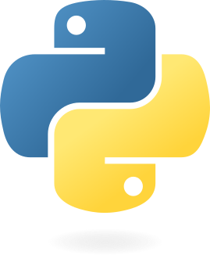
Welcome to the Python Programming Language!
For more history: https://en.wikipedia.org/wiki/History_of_Python
Introduced in 1991 by Guido van Rossum
Features:
Free and Open Source
Interpreted
Object-Oriented
https://python.org

Slide 7
Free and Open Source
Everyone is free to: download, use, modify and redistribute Python.
Python is developed, in part, by the community of users.
https://docs.python.org/3/license.html

Slide 8
Interpreted
Gene Expression
DNA
mRNA
Protein
Program (text file)
Executable (binary instructions)
Interpretation (line-by-line)

Slide 9
Object-Oriented
DNA
transcribe()
sequence
RNA
sequence
translate()
Protein
sequence
Data
Behaviour

Slide 10
Installing Python
 | Official Installer | Miniconda | Anaconda
Includes Python
Includes pip
Includes conda
Allows easily installing multiple versions
Includes many packages

Slide 11
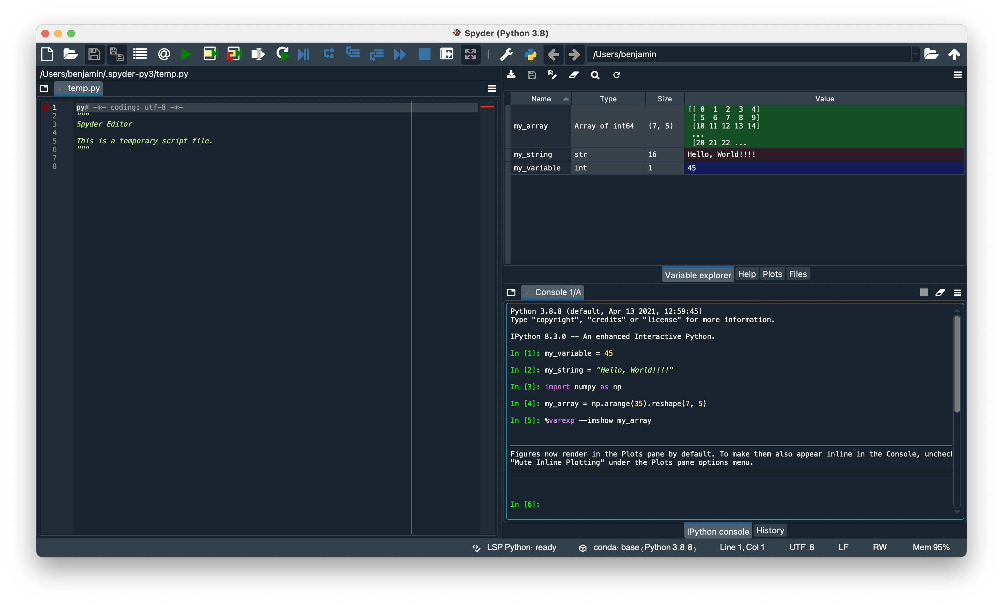
Tools for Programming in Python

Slide 12
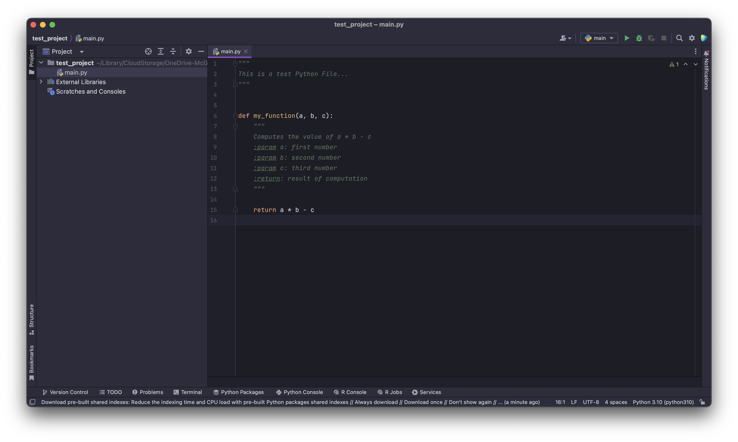
Tools for Programming in Python

Slide 13
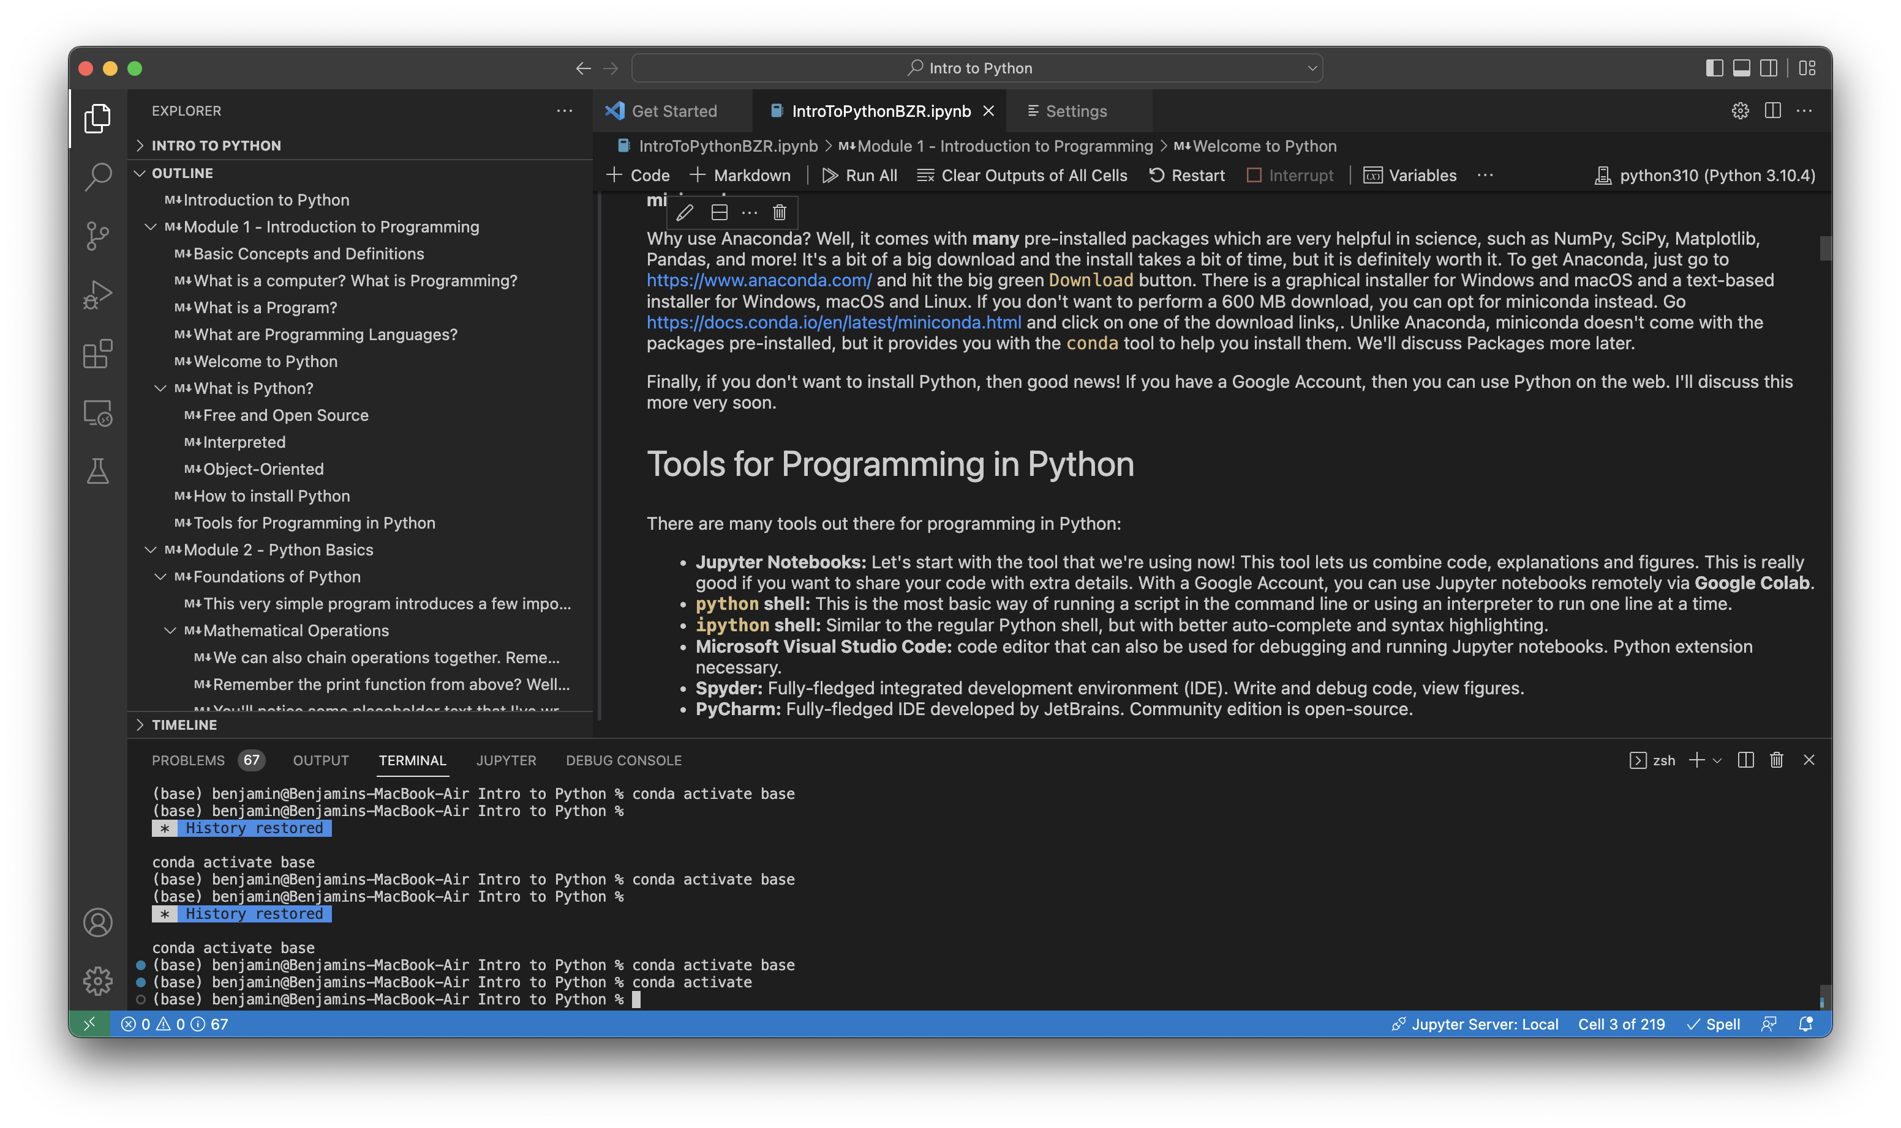
Tools for Programming in Python

Slide 14
Module Summary
Python is a programming language that is open source, interpreted and object-oriented.
There are various ways to install Python.
We can use a variety of tools to program in Python.

Slide 15
Interactive Workshop!
That’s pretty much all that will be in the slides… For the rest, we’ll go to a Jupyter Notebook:
To the repository!

Slide 16
Module 2 Strings and Collections An Object Primer

Slide 17
What is an Object?
Object
Attributes
Methods
Variables
Describe the object
Functions
Compute values
Alter the object

Slide 18
Objects
Car
colour
year
model
turn_on()
turn_off()
change_gear()
toggle_headlights()
Mouse
height
weight
age
sex
genotype

Slide 19
To summarize
Python is a free and open-source, interpreted object-oriented language.
Data can be stored in variables of several types, including strings, integers, floating point numbers and Booleans.
Collection types, such as tuples, lists and dictionaries can be used to store multiple data points.
Control flow and loops, help decide which lines to run and allow lines to be repeated.
Now you are ready to:
Store data in variables and collections.
Perform basic operations on these data.
Use control flow and loops to write powerful code.

Slide 20
Acknowledgements
Thank you to QLS-MiCM for giving me this opportunity and for helping me along the way.
Thank you to the professors from the McGill School of Computer Science for helping me along my programming journey and for inspiring me to share my programming experience with others.
Thank you to Professor Mathieu Blanchette, whose COMP 204 course helped introduce me to Python (back in Fall 2018).
Thank you to the Python community!

